Slide 1
A Time for Everything
A Department Chair’s Survival guide:
Pacing yourself, Using your resources,
and other Useful insights Into the Job
Presented by Jim Gray
Florida Atlantic University

Slide 2

Oh my, How Your Life Has Changed, since you became the “Boss”
But there are some things you can do to keep control of most of it.

Slide 3
Areas that seem to have changed
Almost Overnight…
Relationships:
Perceptions:
Environment:
With your Peers
With the Staff
With upper Administration
With your Students
With the Community
Your perceptions of others
Others’ perceptions of you
Relative importance of tasks
Critical attention to details
Authority and power issues
Work environment
Personal space and time
Control of your work
Control of your time
Preserving your sanity

Slide 4
First, lets look at areas where
Relationships have changed:
With your Peers
With the Staff
With upper Administration
With your Students
With the Community

Slide 5
Examples of how your
Relationships have changed:
With Peers:
You are now “The BOSS”
Because You are now “The BOSS”
This puts you under immediate suspicion
of having gone over to THE DARK SIDE

Slide 6
First, lets look at how your
Relationships have changed:
With Staff:
You are now someone to be feared,
not just tolerated
Some don’t know how they are supposed to relate to you in your new role.
It is up to you to put them at ease…

Slide 7
Another place your
Relationships have changed:
With Administration:
You are now one of them, but
they are not sure about you either!

Slide 8
First, lets look at how your
Relationships have changed:
With Students:
You are now thought of as having
the power to “fix stuff”

Slide 9
First, lets look at how your
Relationships have changed:
With Community: you are now more of a symbol of the university and of your program
You also have to think more about what those community stakeholders need from you…

Slide 10
Changed
Perceptions:
Your perceptions of others

Slide 11
Changed
Perceptions:
Others’ perceptions of you

Slide 12
Changed
Perceptions:
Relative importance of tasks

Slide 13
Changed
Perceptions:
Critical attention to details

Slide 14
Changed
Perceptions:
Authority and power issues

Slide 15
Changed
Perceptions:
Your perceptions of others
Others’ perceptions of you
Relative importance of tasks
Critical attention to details
Authority and power issues

Slide 16
Changes in your
Environment:
Work environment
Personal space and time
Control of your work
Control of your time
Preserving your sanity

Slide 17
Changes in your
Environment:
Work environment

Slide 18
Changes in your
Environment:
Work environment
Personal space and time

Slide 19
Changes in your
Environment:
Work environment
Personal space and time
Control of your work

Slide 20
Changes in your
Environment:
Work environment
Personal space and time
Control of your work
Control of your time

Slide 21
Changes in your
Environment:
Work environment
Personal space and time
Control of your work
Control of your time
Preserving your sanity (what’s left of it)

Slide 22
Attributions are going to be made about your motives...

Slide 23
Attributions are going to be made about your motives...
(Even when you sneeze!)

Slide 24
Attributions are going to be made about your motives...
(Even when you sneeze)
So just get used to it…

Slide 25
Here are some other aspects of your new situation:
Students now expect:
Instantaneous response
Absolute accuracy
Unfailing courtesy
Perfect diplomacy
...along with...
Fairness as they see it

Slide 26
Here are some other aspects of your new situation :
Faculty now expect
Instantaneous response
Absolute accuracy
Unfailing courtesy
Perfect diplomacy
...along with...
Fairness as they see it

Slide 27
Here are some other aspects of your new situation :
Dean now expects:
Instantaneous response
Absolute accuracy
Unfailing courtesy
Perfect diplomacy
...and “by the way”...
Peace in the department

Slide 28
Control over your time is not going to be nearly as easy as it used to be...

Slide 29
Control over your time is not going to be nearly as easy as it used to be...
“got a minute?”

Slide 30

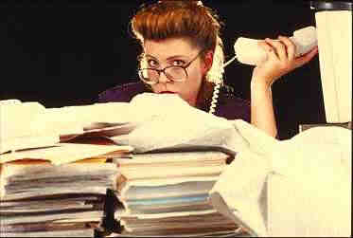

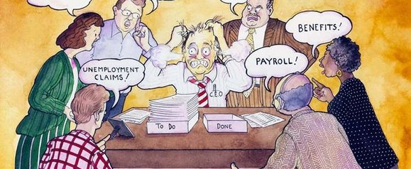

Here is the crux of the Time problem:
Stock Vector Illustration:
Image ID: 116435299
Stock Vector Illustration:
Image ID: 116435299
You cannot possibly remember all this stuff; yet…
You are expected to have it instantly available, always!

Slide 31


The secret weapon (good notes!)

Slide 32
You are now “official”

Slide 33
You are now “official” and that means...

Slide 34
You are now “official” and that means...
There is no longer any such thing as
“off the record”
DON’T KID YOURSELF.
There are no “PRIVATE CONVERSATIONS” anymore

Slide 35
You are now “official” and that means...
There is no longer any such thing as
“off the record”
DON’T KID YOURSELF.
There are no “PRIVATE CONVERSATIONS” anymore

Slide 36
Pointers Collected by watching the best
Delegation
Relationships
Follow-up
Staff want meaningful tasks
Give specific direction
Make expectations clear
Set a date for completion
Avoid verbal requests
Know your people
Spend time really listening
Personalize communications
Listen first, pause, respond
You may sometimes be the
only “adult-in-the-room”
The list of Critical Dates
The Reminder/Tickler File
Automatic reminders
Checking up as a regular event
Don’t play “gotcha!”

Slide 37
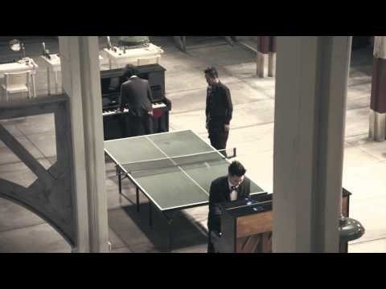
Ever Have a Day Like This?

Slide 38
More Great Benchmarks
Take control of your office space and time
  Stand up to greet people as they enter (this exudes courtesy)
  For a short meeting—Never sit back down. (try this, it usually works)
  When it does not work, walk toward the door! (this always WORKS!)
Ask these questions as politely as you can:
  Can this wait until tomorrow?
  I have about three minutes, will that be enough time?
  What do you think should happen?
  Does this consider everyone involved?
After a while, folks will get the message...

Slide 39
Things I have learnt thru Example
Have your own data before you even ask the question
Ask where the data being presented to you originated
Don’t be shy about asking for corroboration/elaboration
When you delegate responsibility, also include confidence:
  “I will support whatever decisions you make in my absence”

Slide 40
Develop Good Listener Skills it also helps to keep good notes!
Sometimes all the other person wants is for somebody to listen
  When you think you understand, ask if your summary is accurate
  What do you need? / Can you survive without it?
Always wait until you have “the rest of the story”
  There is always another perspective to consider
  Things frequently dissipate in the face of focused impartial attention
There are, however, exceptions to the rules...

Slide 41
URGENT vs. IMPORTANT few situations are ever “both”
Many times, by just letting some time pass,
a majority of situations will resolve themselves
without your intervention
Other times, you have to act quickly
and enforce your best judgment,
to avoid a regrettable escalation
Knowing how to tell the difference is a key skill
that you should work to develop
Unfortunately you will learn this the hard way,
like everyone who has gone before you...

Slide 42
It will be OK.
You will get the hang of this
Just don’t let it go to your head.
Keep on being yourself, but be more perceptive of others’ expectations!
Nobody likes a martinet.

Slide 43

Wisdom for the Ages
“This too, shall pass”
©1978 California Prune Advisory Board

Slide 44
The end…
Beam me up, Scotty!

